Slide 1
How to access Probation Dynamic Framework (DF) Market Warming material on Jaggaer (formerly Bravo)

Slide 2
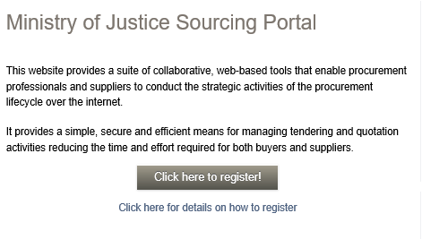
Creating an account
Note: if you already have a Jaggaer (formerly Bravo) account for MoJ procurements, please do not create a new account and instead log in as normal. If you are unsure whether you already have an account, please email esourcing@Justice.gov.uk and the team will check for you.
1. If you do not already have an account, follow this link: https://ministryofjusticecommercial.bravosolution.co.uk/web/login.html
2. You will see ‘Click here to register!’. Follow that link and complete your organisation’s details to register.

Slide 3
How to Access DF Market Warming materials
1. Once you are logged in, click on ‘PQQs open to all suppliers’.
2. In the search bar type ‘Probation Dynamic Framework Market Warming’. Click on the event titled ‘PQQ_199 - Probation Dynamic Framework Market Warming’.
3. Click ‘Express an Interest’ in the green box,
Note: organisations do not need to respond to this event. It is for market warming purposes only.
IMPORTANT: documents may be updated by the Authority throughout market warming. Please check the PQQ on Jaggaer regularly to ensure you’re referring to the latest document.

Slide 4
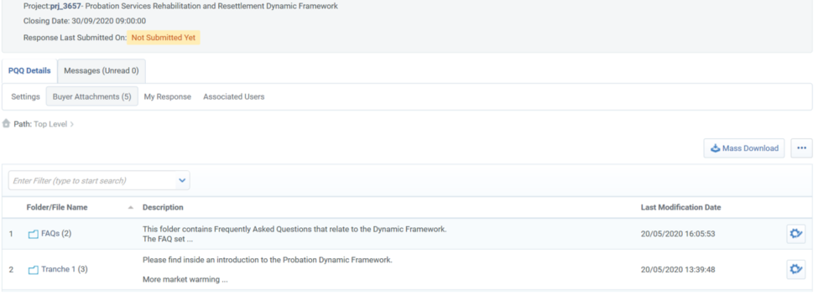
How to Access DF Market Warming materials
You will then see a screen that looks like this.
Relevant information can be found under ‘Buyer Attachment’ and ‘My Response’.

